Slide 1


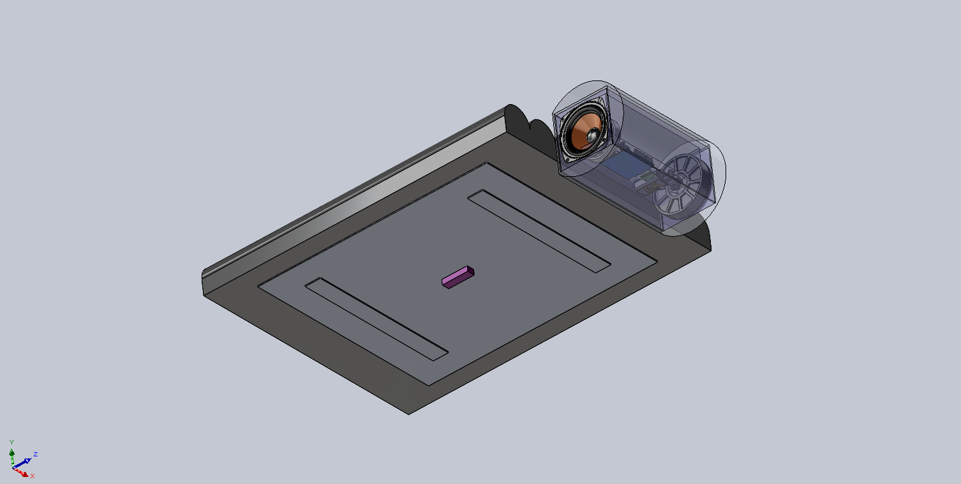
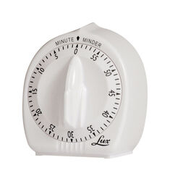
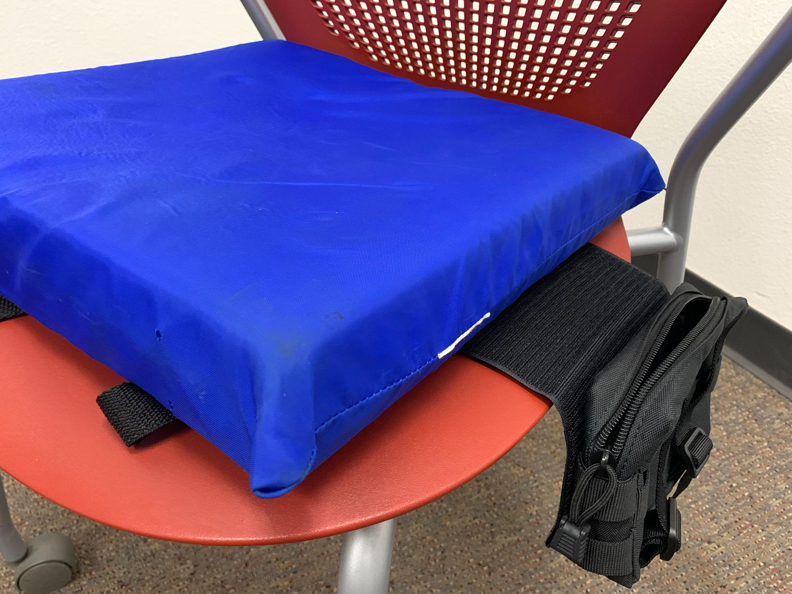
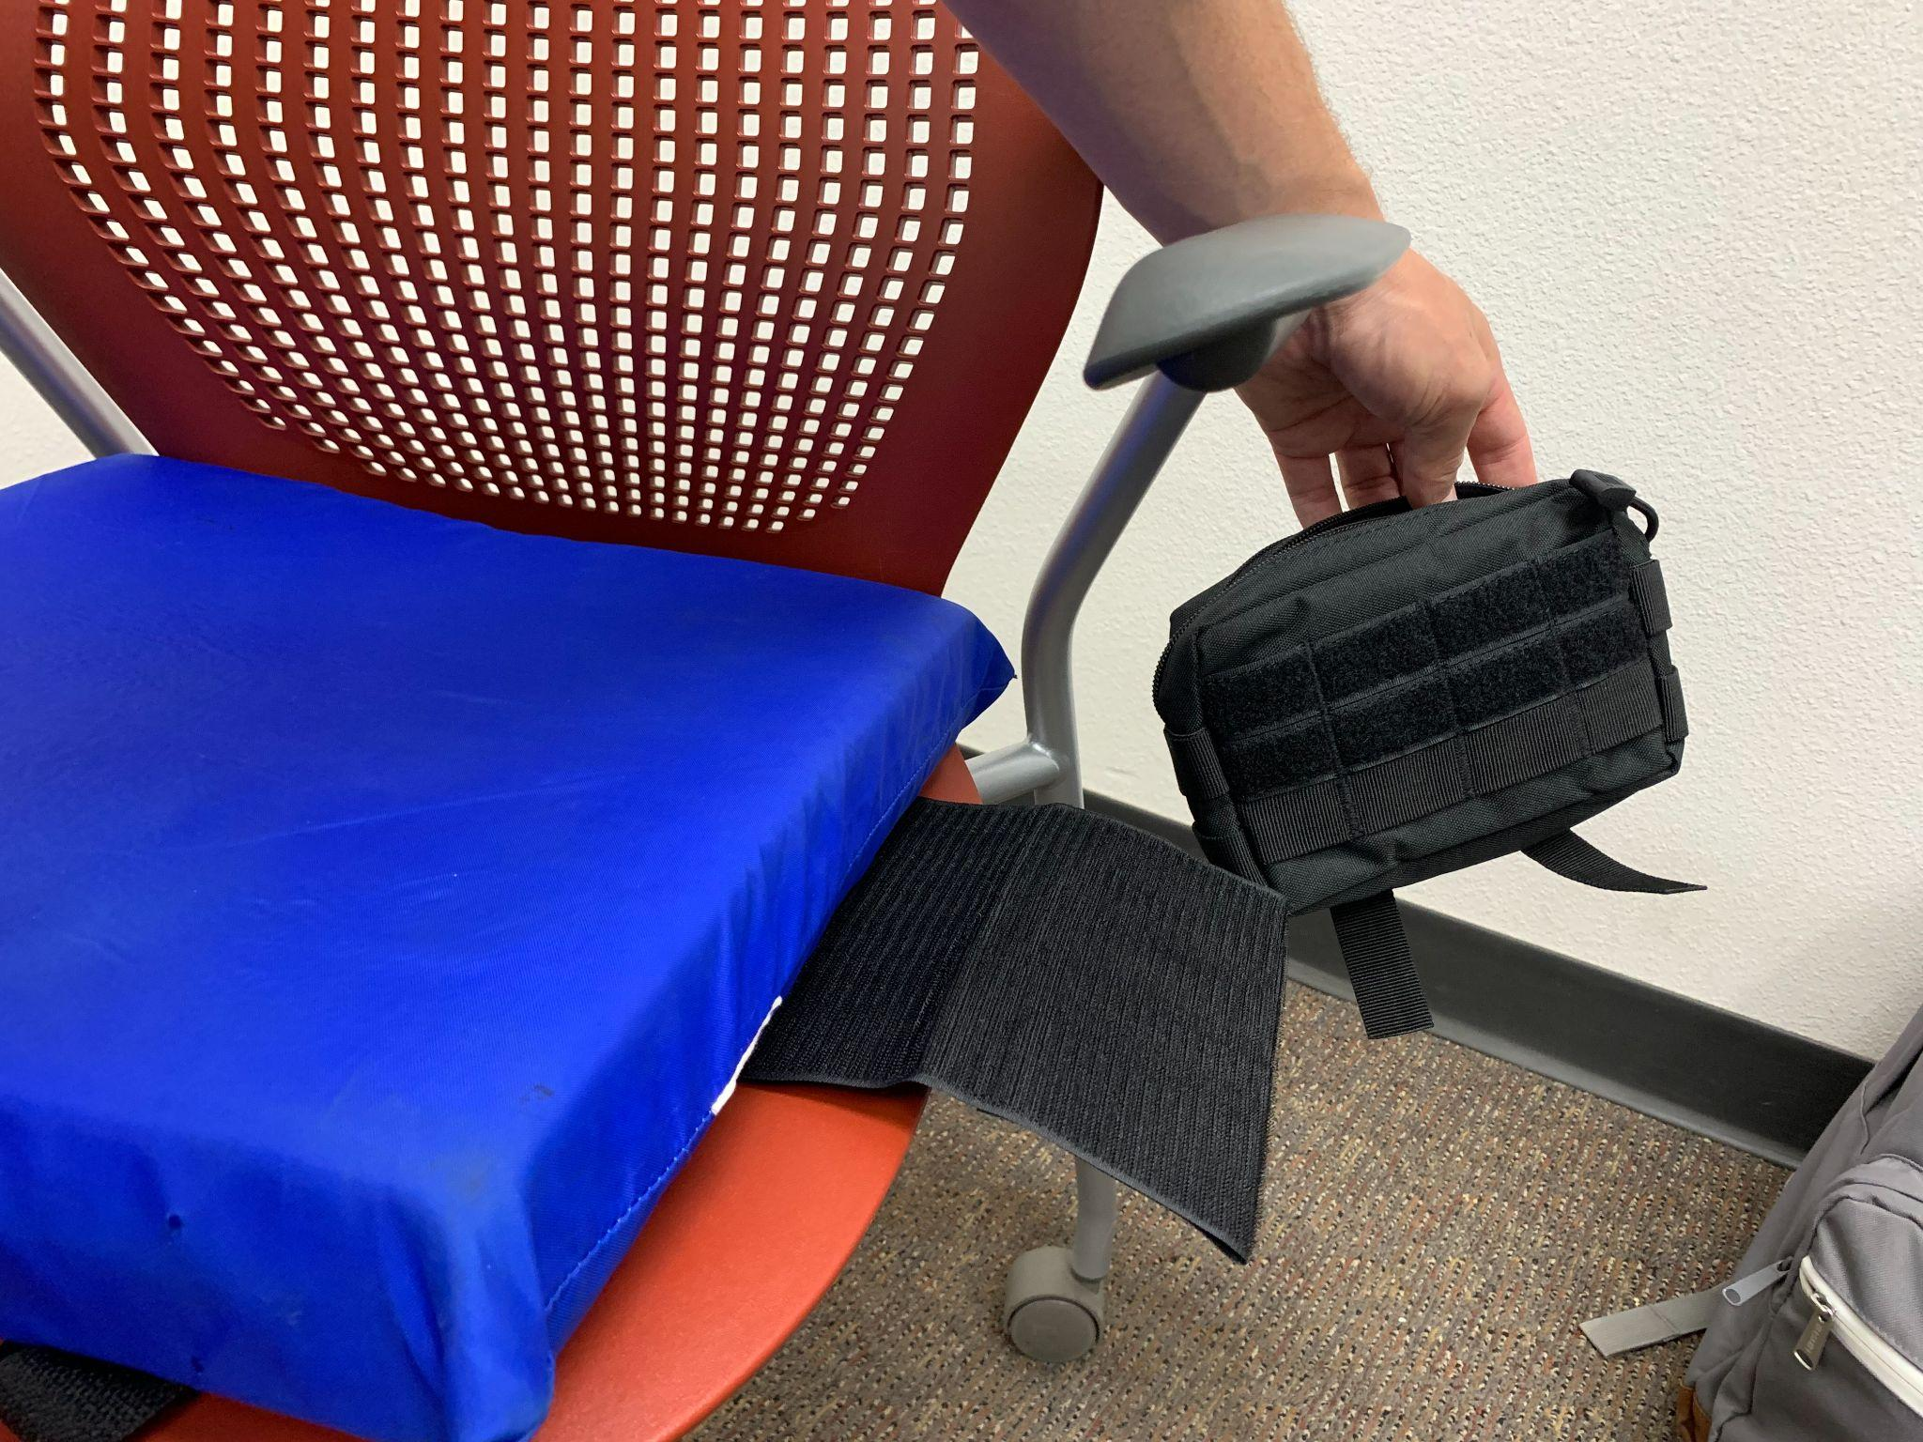
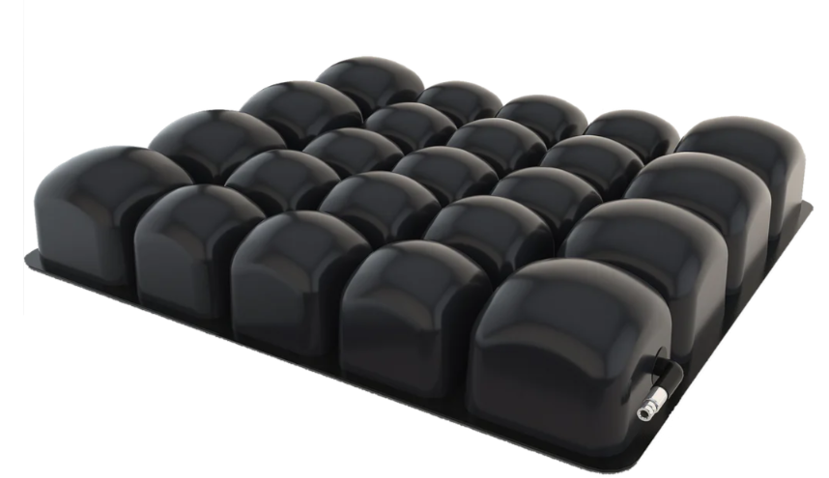
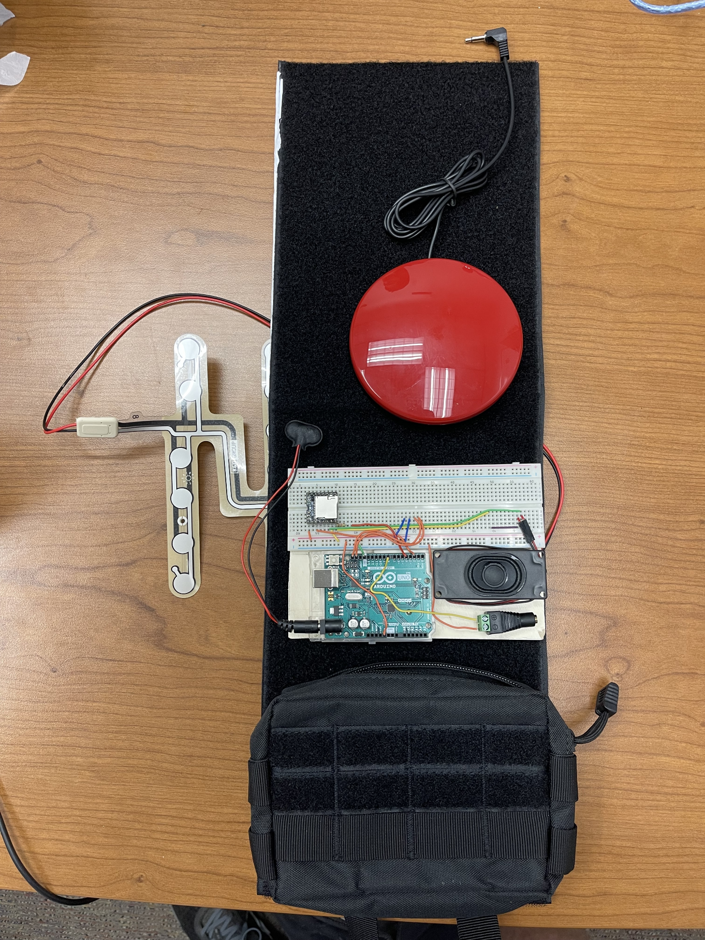
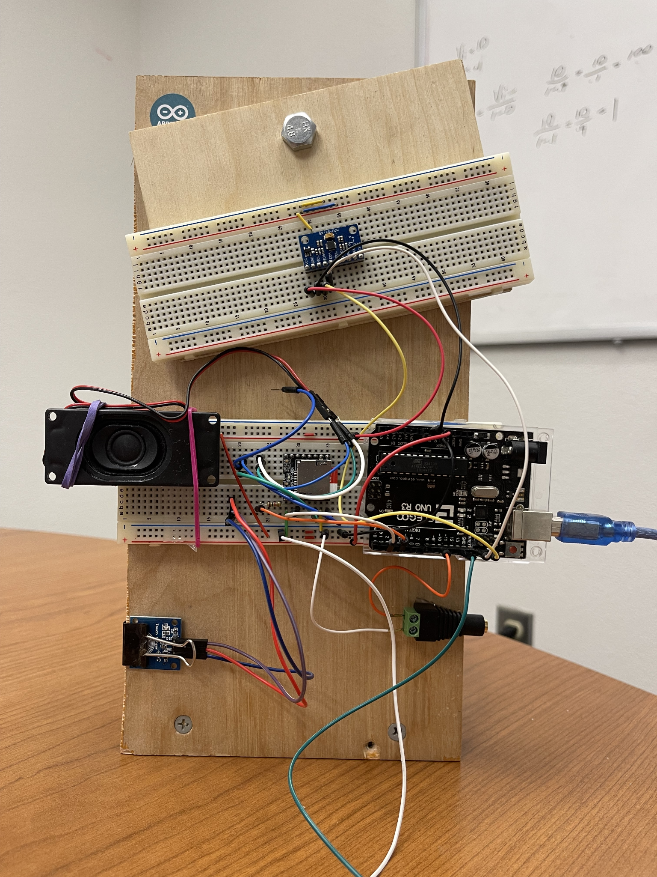
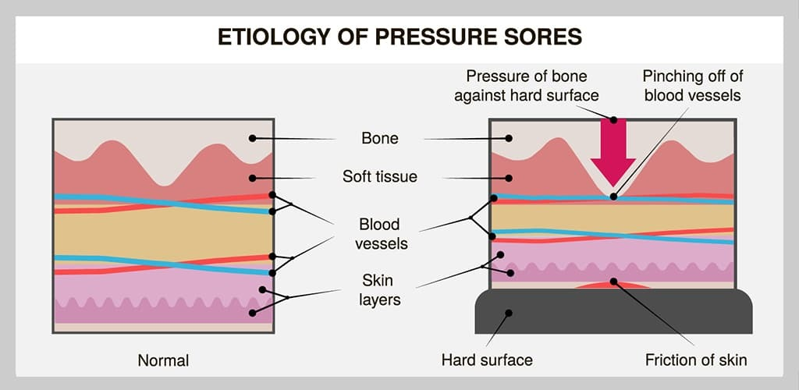
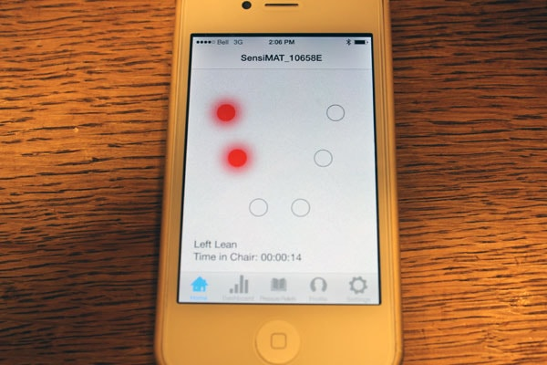
Time Machine
Jason Mester, Madelyn Molnar, Aditya Patil, Atanu Kothe, Suhrud Joglekar
Introduction
Proposed Solution
Related Work
People with spinal cord injuries need to shift their weight every 20 minutes to prevent pressure sores, as their body no longer shifts its weight on its own. People often forget to do these weight shifts, though. As such, a device was needed that would reminded people with spinal cord injuries to do their weight shifts to keep them from developing pressure sores.
Kitchen Timers: This is what patients currently use. While it keeps track of time, it does not keep track of weight shifts and makes an annoying sound.
Chair-based Systems: A number of systems exist that are installed on a chair to monitor pressure points. These systems can consist of air-filled cushions, smart textiles, and more. They have a variety of disadvantages, such as their price or being difficult to install. None of these keep track of if the patient performs the weight shift as well.
Background Information
Implementation
People with spinal cord inquiries lose the urge to shift their weight when it is needed. Not shifting their weight can cause pressure to build up on certain spots of the body and for pressure sores to form. As such, the patient needs to be reminded every so often, roughly 20 minutes if they are sitting, or two hours if they are laying down, to do weight shifts to relieve this pressure.
Apps: Some apps exist that can monitor, through various methods, when a patient needs to do a weight shift. It is difficult for quadriplegic individuals to use touch screens, though.
For further questions or comments please contact team lead Jason Mester: jmmester@asu.edu

